Slide 1




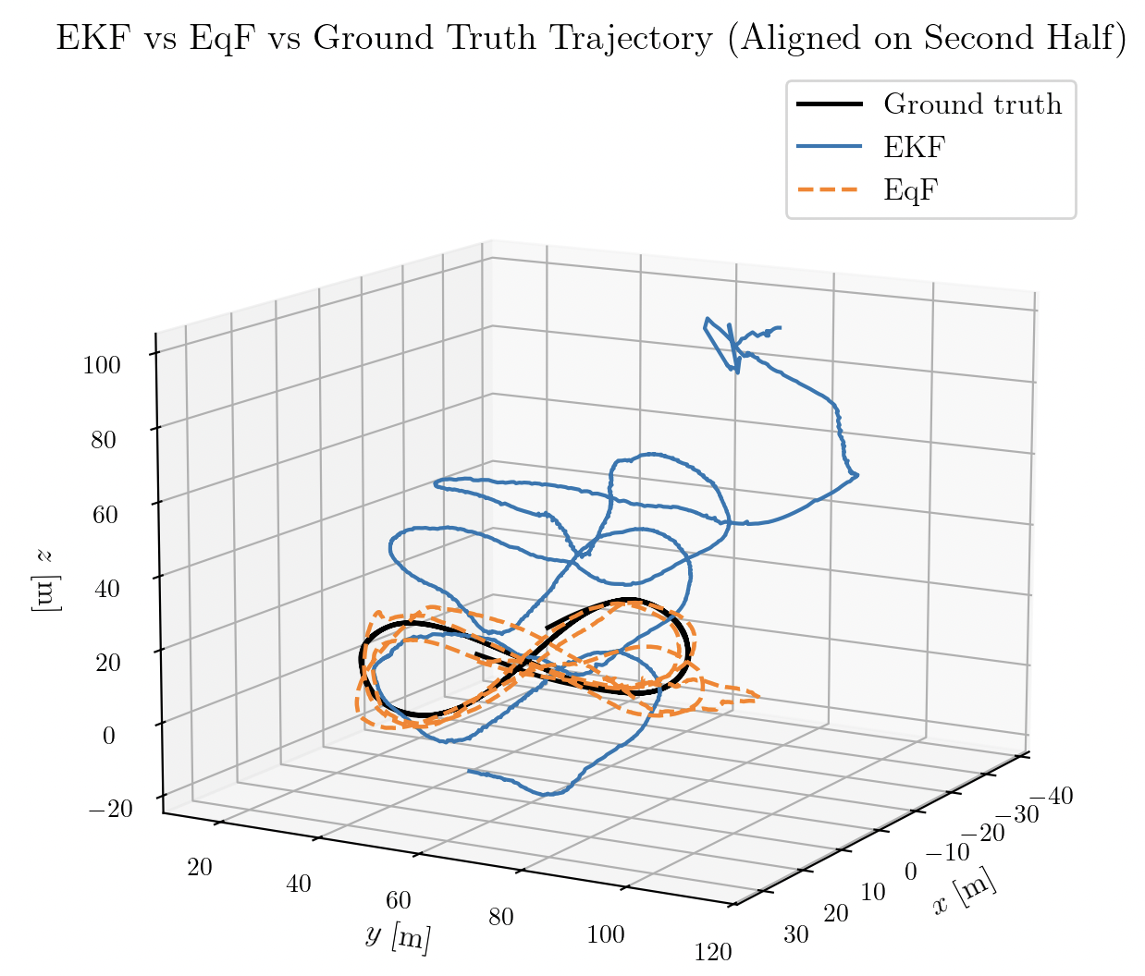
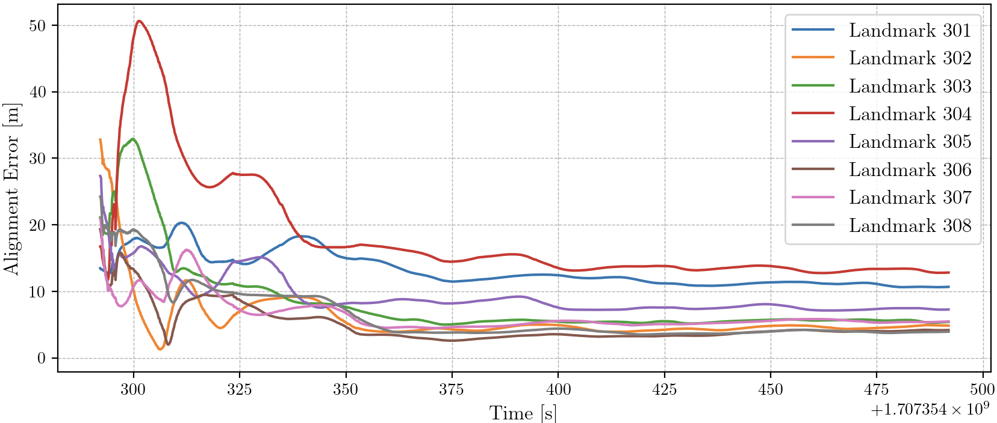

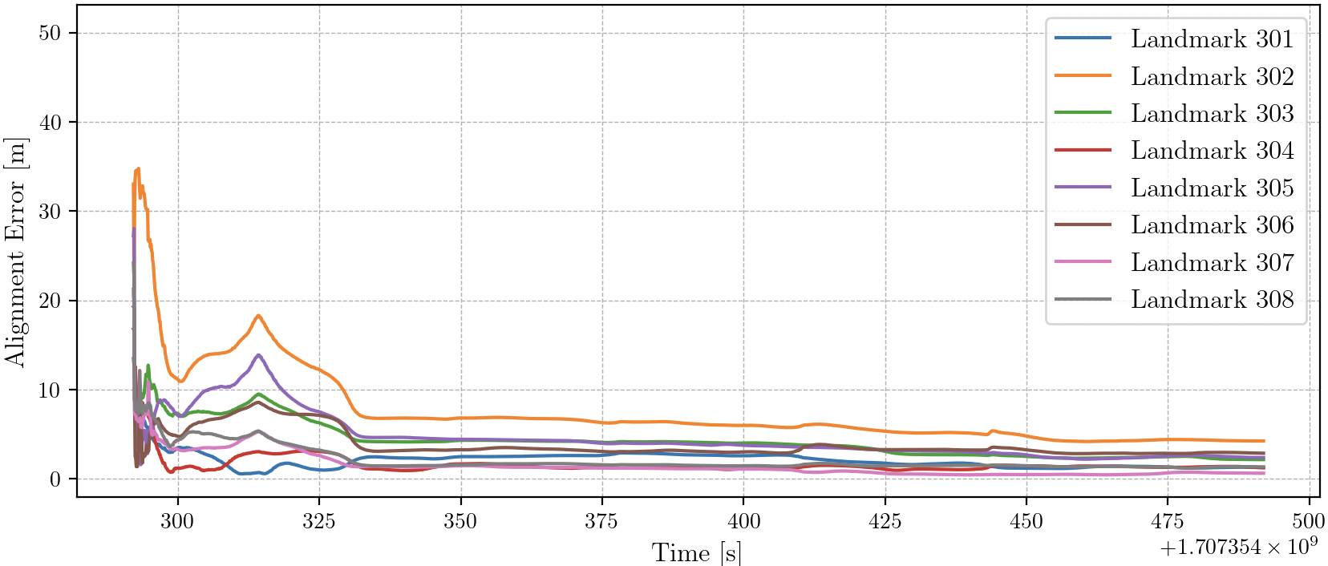


Underwater SLAM system with equivariant (EqF) filter
Brian Ma,
Shawn Ge,
Robert Mahony,
The problem
Localization of an underwater vehicle can cost at least 10k dollar using the Commercial Short Baseline (SBL) localization systems [1]. Such systems requires establishing a network of transponders where their locations are pre-surveyed. The major cost of localization system comes from the surveying process.
Our solution
Our SLAM system only cost around 1k dollar assuming 5 beacons are used in the SLAM. It provides an accuracy similar to USBL systems (less than 1 cm error), and uses an EqF to further enhance the accuracy and robustness comparing to EKF.
EqF with Scaled orthogonal transformations SOT(3) works perfect for beacon range measurements because it decouples the bearing information which is highly uncertain and depth information which is very accurate.
The Challege
Ulternatively, simultaneous Localization and Mapping (SLAM) systems do not require pre-surveyed reference points, so they generally cheaper. However existing SLAM algorithms rely on filters that linearize the kinematics at local coordinates such as Extended Kalman filter (EKF).
The Result
Graphs below shows the performance of EqF on range measurement only SLAM. The Data is collected from previous land rover projects instead of this underwater project.
EKF
Project Roadmap
Phase 1: Design equivariant filter for SOT(3).
Phase 2: Design, implement and test communication protocol
with beacons.
Phase 3: Collect range data with rover and our
beacons in a lake and apply equivariant
filter on the ranging data.
EqF
[1] https://www.waterlinked.com/shop/category/underwater-gps-2
[2] Y. Ge, “Equivariant Filter Design for Range-only SLAM,” Mar. 2025.

